Slide 1
Garbage Collection in Java
System.gc()

Slide 2
Garbage collection
In Java it is the process by which Java programs perform automatic memory management.
When Java programs run on the JVM, objects are created on the heap, which is a portion of memory dedicated to the program.
Eventually, some objects will no longer be needed.
The garbage collector finds these unused objects and deletes them to free up memory.

Slide 3
What is Garbage Collection?
In C/C++, a programmer is responsible for both the creation and destruction of objects. Usually, programmer neglects the destruction of useless objects. Due to this negligence, at a certain point, sufficient memory may not be available to create new objects, and the entire program will terminate abnormally, causing OutOfMemoryErrors.

Slide 4
Cont..
But in Java, the programmer need not care for all those objects which are no longer in use.
Garbage collector destroys these objects. The main objective of Garbage Collector is to free heap memory by destroying unreachable objects.
The garbage collector is the best example of the Daemon thread as it is always running in the background.

Slide 5
How Does Garbage Collection in Java works?
Java garbage collection is an automatic process.
of looking at heap memory, identifying which objects are in use and which are not, and deleting the unused objects.
The garbage collection implementation lives in the JVM.

Slide 6
Types of Activities in Java Garbage Collection
Two types of garbage collection activity usually happen in Java. These are:
Minor or incremental Garbage Collection:
have occurred when unreachable objects in the young generation heap memory are removed.
Major or Full Garbage Collection:
when the objects that survived the minor garbage collection are copied into the old generation or permanent generation heap memory are removed.

Slide 7
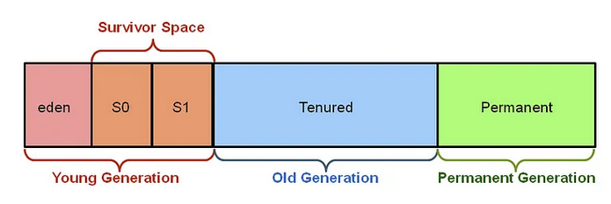

Slide 8
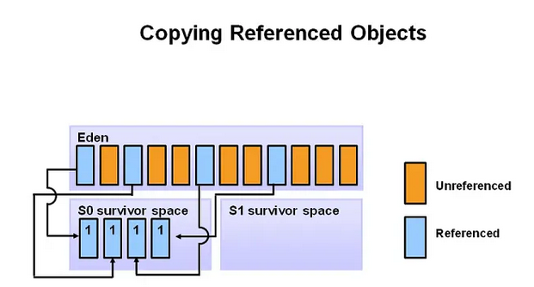
To summarize, it suffices to understand that new objects begin in the eden space and gradually transition to survivor spaces as they survive multiple garbage collection cycles.

Slide 9
old generation
The old generation can be perceived as the repository for long-lived objects.
When objects are garbage collected from the old generation, it triggers a major garbage collection event.
In the given example, any objects that have survived a certain number of cycles in the survivor space are moved by the algorithm to the old generation.
The old generation is represented by a single section known as the tenured generation.

Slide 10
Permanent Generation
The permanent generation is not populated by objects from the old generation.
Instead, the permanent generation is initially populated by the JVM with metadata that represents the classes and methods of the application at runtime.
Occasionally, the JVM may adhere to specific rules for cleaning out the permanent generation, and when this occurs, it is referred to as a full garbage collection.

Slide 11
Important Concepts Related to Garbage Collection in Java
Unreachable objects: An object is said to be unreachable if it doesn’t contain any reference to it.
Integer i = new Integer(4);
// the new Integer object is reachable via the reference in 'i'
i = null; // the Integer object is no longer reachable.

Slide 12
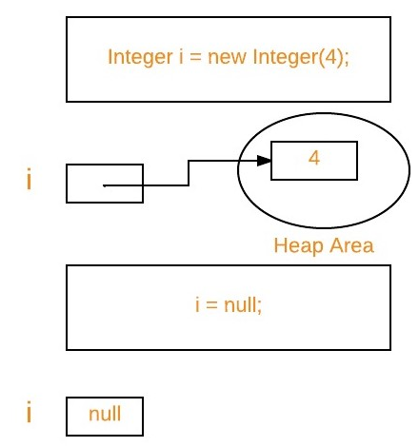

Slide 13
Ways to make an object eligible for Garbage Collector
Even though the programmer is not responsible for destroying useless objects but it is highly recommended to make an object unreachable(thus eligible for GC) if it is no longer required.
There are generally four ways to make an object eligible for garbage collection.
  Nullifying the reference variable
  Re-assigning the reference variable
  An object created inside the method
  Island of Isolation

Slide 14
  Island of Isolation
Object 1 references Object 2 and Object 2 references Object 1. Neither Object 1 nor Object 2 is referenced by any other object. That’s an island of isolation.
Basically, an island of isolation is a group of objects that reference each other but are not referenced by any active object in the application. Strictly speaking, even a single unreferenced object is an island of isolation too

Slide 15
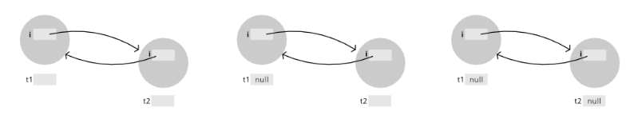
Both the objects have external references t1 and t2. t1 = null : Both the objects can be reached via t2.i and t2 respectively. t2 = null: No way to reach any of the objects.
Now, both the objects are eligible for garbage collection as there is no way we can call them. This is popularly known as Island of Isolation.

Slide 16
public class Example {
GFG i;
public static void main(String[] args)
{
Example t1 = new Example();
Example t2 = new Example();
t1.i = t2; // Object of t1 gets a copy of t2
t2.i = t1; // Object of t2 gets a copy of t1
// Till now no object eligible for garbage collection
t1 = null;
// Now two objects are eligible for garbage collection
t2 = null;
// Calling garbage collector
System.gc();
}
protected void finalize() throws Throwable
{
System.out.println("Finalize method called"); // Print statement
} }

Slide 17
Ways for requesting JVM to run Garbage Collector
Once we make an object eligible for garbage collection, it may not destroy immediately by the garbage collector. Whenever JVM runs the Garbage Collector program, then only the object will be destroyed. But when JVM runs Garbage Collector, we can not expect.
We can also request JVM to run Garbage Collector. There are two ways to do it :

Slide 18
request JVM to run Garbage Collector
Using System.gc() method: System class contain static method gc() for requesting JVM to run Garbage Collector.
Using Runtime.getRuntime().gc() method: Runtime class allows the application to interface with the JVM in which the application is running. Hence by using its gc() method, we can request JVM to run Garbage Collector.
There is no guarantee that any of the above two methods will run Garbage Collector.
The call System.gc() is effectively equivalent to the call : Runtime.getRuntime().gc()

Slide 19
Finalization
Just before destroying an object, Garbage Collector calls finalize() method on the object to perform cleanup activities. Once finalize() method completes, Garbage Collector destroys that object.
finalize() method is present in Object class with the following prototype.
protected void finalize() throws Throwable

Slide 20
finalize() method
Based on our requirement, we can override finalize() method for performing our cleanup activities like closing connection from the database.
Object class finalize() method has an empty implementation. Thus, it is recommended to override the finalize() method to dispose of system resources or perform other cleanups.
The finalize() method is never invoked more than once for any object.
If an uncaught exception is thrown by the finalize() method, the exception is ignored, and the finalization of that object terminates.

Slide 21
Advantages of Garbage Collection in Java
It makes java memory-efficient because the garbage collector removes the unreferenced objects from heap memory.
It is automatically done by the garbage collector(a part of JVM), so we don’t need extra effort.

